Slide 1




Module 11 – Implementation Options
Training Modules for Applying the Mitigation Hierarchy:
Planning Policy and Projects for No Net Loss or a Net Gain of Biodiversity
Module 11
Implementation Options

Slide 2
Module on Implementation Options – Abstract
This module introduces the key issues associated with delivering effective mitigation on the ground over the long term. Where other modules looked at the range of issues involved in the design of mitigation measures (e.g. following the mitigation hierarchy, applying exchange rules and metrics, working with stakeholders), this module is about implementation of the agreed mitigation measures.
It sets out the issues to be considered, eg how will the offset operate and be managed, be financed, and be monitored and evaluated? It describes the different options for who can undertake the implementation – from the developer, to the state, to third parties, the kind of arrangements that are needed to make this work, and the way offsets can be supplied by third parties using a market mechanism. It describes the most important needs for successful implementation and various mechanisms for delivery.
Illustrations introduce the way that single offsets, aggregated offsets and conservation banks can work in the landscape. Conservation banking in the USA is given as an example.
The module introduces biodiversity offset (or compensation) management plans and provisions for monitoring, evaluation and enforcement. Finally, the module concludes by reviewing conservation trust funds as a mechanism for securing finance for long-term mitigation measures.

Slide 3
Module on Implementation Options - Contents
Contents | Slides
Typical stages with design and implementation of mitigation; key issues in offset implementation: who and how? Third party supply of offsets | 4
Key aspects for successful implementation; implementation options: mechanisms | 5-10
Single offsets, aggregated offsets and conservation banks. How does a US Conservation Bank work? | 11-18
Biodiversity Offset (or Compensation) Management Plans; Monitoring, evaluation, adaptation, enforcement | 19-22
Conservation trust funds | 23-27
Take home messages | 28

Slide 4
Typical stages with mitigation
Two broad phases:
Design
(short term)
Orientation & planning, with stakeholder involvement;
Applying the mitigation hierarchy;
Quantifying residual impacts and offset needs;
Determining offset options: sites, activities;
Designing final offset: prepare Biodiversity Offset Management Plan
Establishing appropriate governance, roles & responsibilities of mitigation, with stakeholder involvement;
Ensuring adequate, sustainable financing and resources;
Establishing operations and management;
Implementing management plan - adaptively
Monitoring and evaluation.
Implementation
(long term)
Notes:
The design of compensation and biodiversity offsets is technical and comparatively short (lasting between months and a few years), whereas the implementation of compensation and offsets is practical and can last several decades or longer. Monitoring and evaluation of implementation is vital. Adaptive management enables the goals set for the compensation or offset in the design to be achieved.

Slide 5
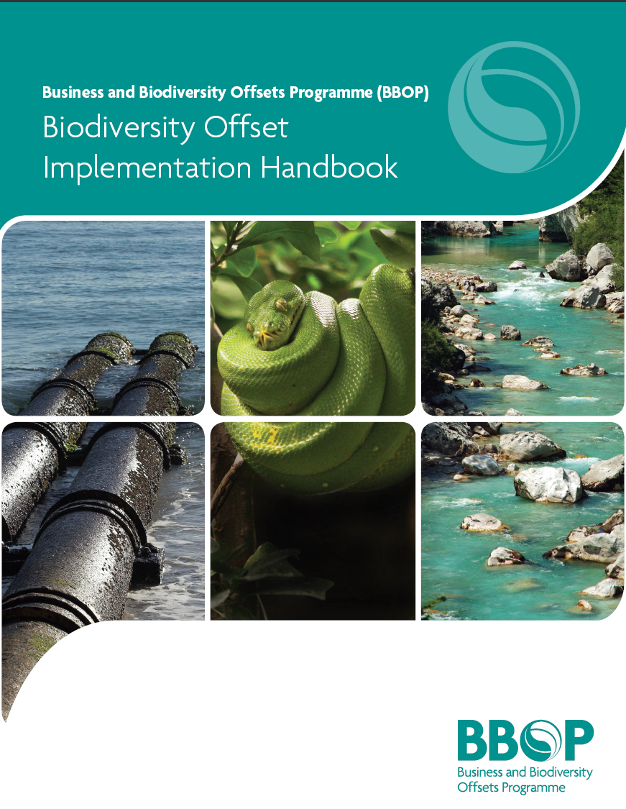
Key issues in Offset Implementation
How will the offset operate and be managed?
How will the offset be financed?
How will the offset be monitored and evaluated?
Roles and Responsibilities of Potential Stakeholders
Calculate short and long-term costs
Implementation Performance
Potential Trust Fund Options
Impact Performance
Legal Issues
Institutional Issues
Potential Non-Trust Fund Options
Link Impact and Performance
Biodiversity Offset Management Plan
Additional Revenue Options for Sustainability
Adaptive Management
Verification and Certification
Notes:
This slide shows 3 key issues of offset implementation. For the offset to work, you need to check that:
Proper measures are in place to ensure the offset is properly operated and managed.
The offset activities are financed over the long term.
The progress of offset implementation will be monitored and evaluated over the long term.
Under each of these main headings, you’ll see different considerations that need to be taken care of.

Slide 6



Implementation: who & how?
Developer and/or partners (NGO, consultant, multi-stakeholder group) undertake the offset
Developer pays a government authority ‘in lieu’
Developer buys sufficient ‘credits’ from a landowner or conservation bank to offset its impacts.
Notes:
Offset implementation is arguably the most important part of an offset, to ensure that what was planned on paper is actually properly and well delivered on the ground over the long term to achieve NNL. While offset design is a relatively intense and comparatively short phase, offset implementation is for the long-term.
So, one key question is – how can an offset be delivered? There are three main ways in which implementation can take place.
The first is the ‘Do It Yourself’ method. Under ‘developer initiated offset implementation’, policy may encourage or require compensation or offsets, but the government generally takes a non-interventionist stance on the manner of their implementation, and the onus rests with the developers to find their own compensation activities or offsets (whether voluntary or required by regulation). As long-term implementation of conservation activities is often not a priority or particular expertise of many developers, they may find partners or agents to implement the compensation or offset on their behalf, for instance, NGOs, local communities, or a mixture of different stakeholders.
Under ‘In lieu fees’, a government agency stipulates a payment from the developer with the intention of deploying the funds at a later date to identify and implement a suitable offset or compensation.
Markets can also be used to supply biodiversity compensation activities or offsets for developers. Such markets do not usually develop spontaneously, but require government intervention to set up the key components. Properly designed and operated, markets can be very effective in supplying offsets and compensation in a timely and cost-effective manner.
While all three mechanisms are available and in use in several countries, there is a growing preference for offsets to be prepared by third parties such as local groups and conservation banks. In the US, for example, there is now a preference for wetland and conservation banking – i.e. purchasing of credits, rather than either of the other two mechanisms. This is based on better outcomes for conservation. The 2008 revision of the Wetland Mitigation Rule only allows in lieu fees for wetland mitigation when there is no mitigation bank in the service are or if the developer can prove that the in lieu fee payment will deliver better conservation outcomes. Where in Lieu Fees are used there needs to be a strict accountability and it must be demonstrated that the conservation actions will be delivered.
There are some likely exceptions. For instance, where impacts are smaller and individual offsets appear less practical it may be appropriate to develop an process for collection of in lieu fees to be used to conserve single, bigger areas that aggregate the offsets. However to be successful there needs to be a clear definition of the conservation objectives for the compensation in question, clear accountability in determining the cost of delivering that conservation, and an appropriate institution (transparent, able to be audited) who can manage the in-lieu funds that would be managed.
Again – the objective is do undertake an offset using a effective standard that can achieve no net loss goals….the in lieu fee is something that should be considered only as a last resort.

Slide 7

Implementation: where and how?
On developer’s land, protected in perpetuity
New or upgraded protected areas (including community protected areas)
Contracts with landholders (including payments for ecosystem services)
Partnership
Engage local communities
You need:
Offset/Compensation Management Plan
Legal arrangements
Trust fund, or other long term financial mechanism
Monitoring, evaluation, adaptive management

Slide 8


Third party supply of offsets through a market
Developers = “BUYERS”
Credit Register
Record of ownership
Provides transparency & accountability to the market
Provides market confidence that the credits meet the standards
Single place where information about credits is recorded
Ensures credits are only ‘used’ once
Brokers
Conservation Banks
Over the counter
Create credits:
Landowner agreements
Land surrender
Upgrade protected areas
Government
“SELLERS”
=
Landowners
=
Notes:
This is an illustration of how the offset system can work. It is adapted from the system in place in Victoria, Australia.
Essentially, developers need to demonstrate No Net Loss to get permission to go ahead with their projects.
The developer’s impacts are assessed by government. Small impacts are assessed by local authorities (using simple metrics), while more significant impacts are assessed by national agencies, using the metrics and methodologies set out in the national law and regulations. This process defines the offset that the developer needs.
The developer faces a number of choices as to how to fulfill its offset obligations. It can implement the offset itself (subject to the same standards as others face) if it would like. Alternatively, it can obtain its offset from ‘third parties’, namely landowners prepared to generate conservation credits on their land or from specialist conservation banks.
‘Sellers’ can therefore include farmers, Parks/Protected Areas (including private and community PAs), communities, local authorities, NGOs, conservation banking companies
The developer can find third party offsets by consulting a broker.
Once the offset is defined and its implementation is established according to national standards, it is entered in the National Biodiversity Credit Register. We’ll discuss registers later, but essentially the register is needed to prove the offset meets national standards and to make sure the offset isn’t sold twice to different companies.

Slide 9

Key aspects for successful implementation?
  Clear roles and responsibilities and details regarding:
        Offset management
        Governance/oversight
        Monitoring and enforcement
        Financing
  Management plan and agreements with organisations implementing the offset
  Other legal and institutional arrangements (eg contracts, easements, granting land to protected areas etc)
  Budget and financial arrangements (eg trust funds) for funding the offset activities
Biodiversity Offset Management Plan
Introduction
Project Impacts & Mitigation
Residual Impacts
Offset Design
Implementation –
What, when, who, where, etc.
Reporting
Etc.
$$$
Notes:
Offset implementation is for the long term. How long? Some offset systems require offsets to last ‘in perpetuity’: forever!
Others stipulate that the offsets should last at least as long as the impacts of the project last.
Some of the principal components required for successful offset implementation are listed here.

Slide 10
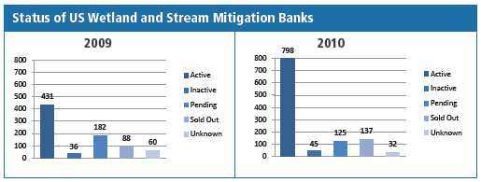

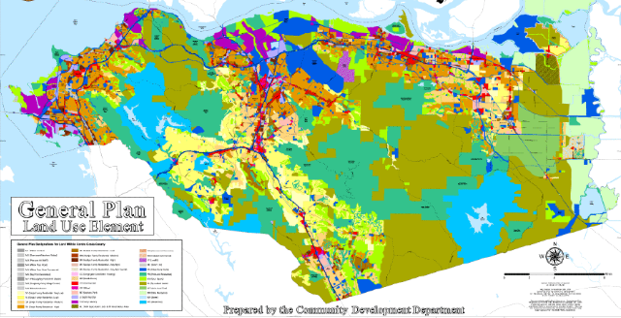
Implementation options: Mechanisms
Biobanks (or conservation banks)
Contract
Covenant/servitude
Insurance
Land-use designation
Lease
Performance bonds
Trust fund

Slide 11
Implementation
Single offsets, aggregated offsets, conservation banks

Slide 12
  Single developer & compensation
Impact site –local community
Plains habitat
Mountain habitat 1
Protected area 1
Ridge line
Project 1
Developer’s project site
Proposed compensation site, close to impact;
both habitats
Protected area 2
Mountain habitat 2
Geo-political boundary

Slide 13
  Single developer, composite compensation
Plains habitat
Impact site –local community
Mountain habitat 1
Protected area 1
Ridge line
D1
Proposed compensationsite #1, close to impact community;
both habitats
Developer’s project site
Offset site – local community
Proposed compensation site #2,
connectivity
Protected area 2
Mountain habitat 2
Geo-political boundary

Slide 14
  Multiple developers, Multiple compensation
Plains habitat
P4
Mountain habitat 1
Developers’ project sites (P1-P4)
P 3
Protected area 1
Ridge line
P 2
Project 1
Compensation sites
Protected area 2
Mountain habitat 2
Geo-political boundary

Slide 15
  Multiple developers, Conservation bank
Plains habitat
Mountain habitat 1
Developers’ project sites
Protected area 1
Ridge line
P4
P3
Project 1
P1
P2
Conservation bank
Protected area 2
Mountain habitat 2
Geo-political boundary

Slide 16

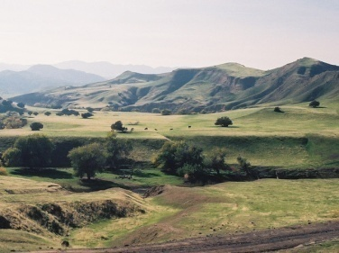
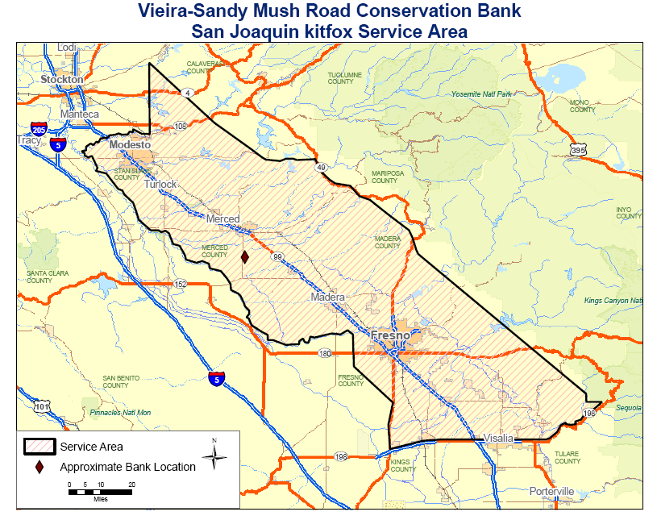
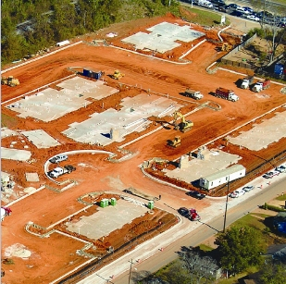

  How does a US conservation bank work?
Impact 7 acres of kit fox habitat
Incidental take permit from FWS
Developer buys 7 credits to satisfy permit requirement
333 acres
Banking agreement with USFWS
Management plan
Endowment fund
Cons easement
$65,000 credits
Notes:
Let put some of these concepts in context – with an concrete example
This is a map of the VSMR species bank - red diamond
was a 333-acre family ranch owned by the Vieira Family
is home also to the endangered San Joaquin Kitfox
the Viera family worked with USFWS
to set up cons easement, Mngt plan, non-wasting endowment fund
in exchange, FWS gave them legal rights to sell 333 kitfox offset credits
they can sell into a service area deemed biologically relevant by FWS (shaded area)
Example of a credit sale
say a new homes developer in Fresno impacts 7 acres of Kit Fox habitat
Need a permit from FWS, to make this impact
To satisfy permit requirements, buy can credits from Vieira bank
the bank retains the legal liability for the ecological performance of the credit

Slide 17

Basic Features of Conservation Banking
Asset/Product
Legal Agreement
Management Plan
Endowment Fund
Service Area
Strategic Site Selection

Slide 18
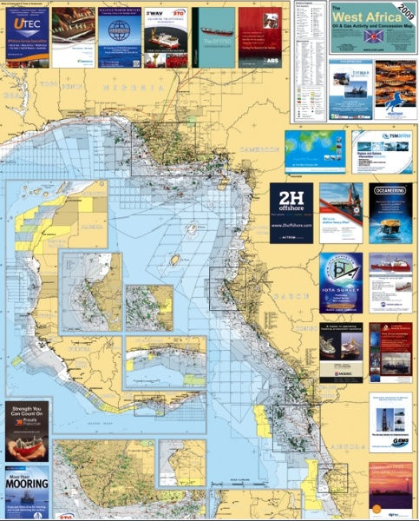
Benefits of conservation bank
Ecological
Greater ecological value
Strategic placement
Avoid temporal loss of habitat
Turns a liability into an asset
Administrative
Easier ecological monitoring
Reduces offset costs through economies of scale
Work to the same performance standards.
Transfer of legal liability
Reduces permitting time

Slide 19
Implementation
Biodiversity Offset (or Compensation) Management Plans
– AND –
Monitoring, evaluation and enforcement

Slide 20
Biodiversity Offset or Compensation Management Plan
Offset/Compensation Management Plan
including:
Purpose:
To ensure activities essential for the offset/compensation to succeed are described clearly and budgeted adequately.
To help manage and monitor the activities.
Description of the project and its impacts (location, scale etc)
Description of the mitigation measures and activities, with detailed plan and milestones (including indicators for monitoring)
Description of period of time over which activities will take place.
Budget
Which organisations will implement the activities
Which organisations will govern/have oversight
Reporting requirements

Slide 21
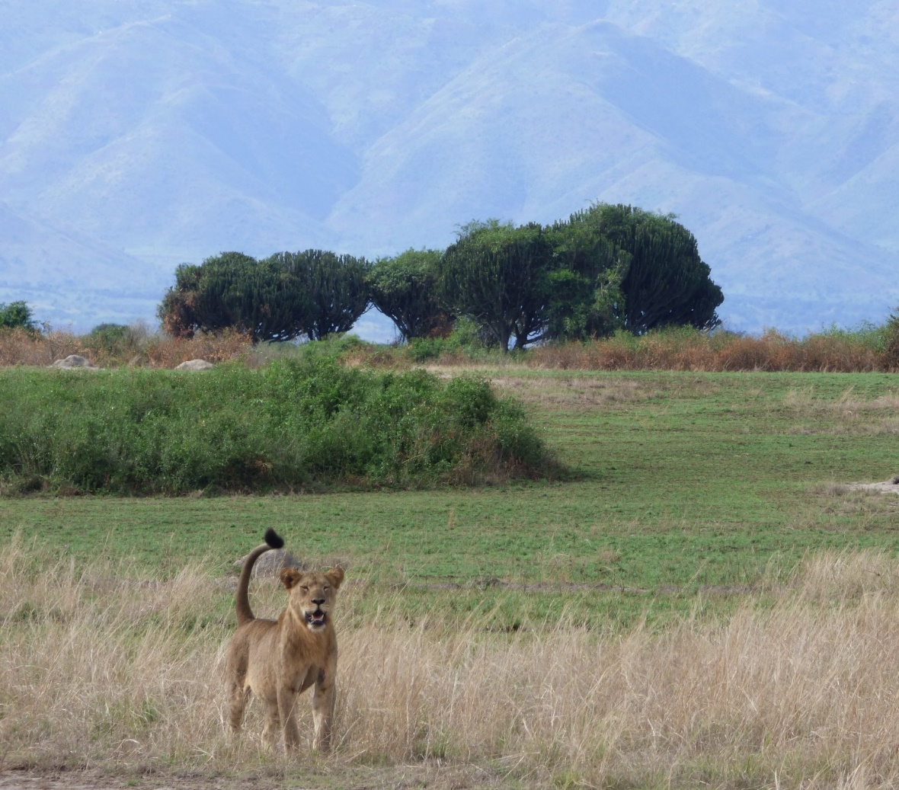
Monitoring and evaluation
Define indicators in the offset/compensation management plan
Independent oversight
Define roles and responsibilities, including for reporting

Slide 22
Enforcement
Government is responsible for checking that the conditions in permits and licenses (including mitigation) are met.
Private organisations may have a role in enforcement: for example, ensuring contracts for performance of mitigation are fulfilled, or pursuing breach of contract or negligence cases.
This needs dedicated staff,
a regular monitoring & evaluation programme,
and a budget.

Slide 23
Implementation
Trust funds

Slide 24
Fund Management
Environmental
Fund
Committee includes members of Fund Board and Offset/Compensation Stakeholders
Management/Steering Committee
Offset/Compensation Funding Window
Approvals, Review, etc.
$
€
Biodiversity Offset Management Plan or Compensation Implementation

Slide 25
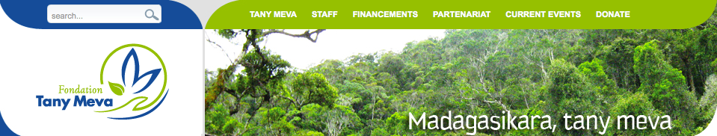
Trust Fund Example
Governance:
Private organization established through Malagasy Law
7 Member Board with representation from NGOs, the private sector, and government – also seven honorary members who provide advice
Board responsible for establishing investment policy
Started in 1996
Finance:
Endowment of 16 million dollars – $10 million in local currency invested in treasury bills in Madagascar and $6 million in dollars invested in the US.
In addition manages shorter term foundation and bilateral/multilateral grants.

Slide 26
Trust Fund Example
Four Areas of Targeted Support
Adaptation to Climate Change
Sustainable Management of Natural Resources
Applied Environmental Education
Environmental Innovations (climate finance, offset management, environmental business)
Providing Support to:
Community organizations
Small landholders
CBOs and NGOs
Credit agencies working with small farmers
Protected area authorities
Community conservation area managers
Environmentally related businesses
Tany Meva Staff review projects, ensure accountability, monitor all projects.

Slide 27

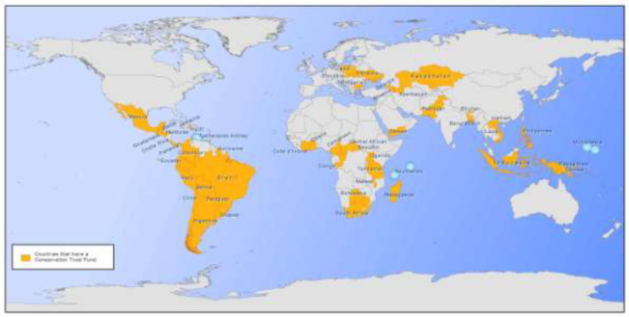
Options for Conservation Funds
Work with existing institutions (for example, conservation trust funds that are already established)
or
Create a new trust fund to manage compensation funds or payments for ecosystem services
or
Develop a combination of new and existing institutions and mechanisms to deliver results, ensure accountability and deal with the risks
Conservation trust funds are established in more than 50 developing countries
Spergel &Taieb 2008

Slide 28
Module on Implementation Options –
Take home messages
Certain commitments and mechanisms are needed to ensure mitigation measures are implemented effectively on the ground over the long term.
These include: appropriate governance, adequate, sustainable financing and resources; establishing operations and management with clear roles & responsibilities; implementing the management plan; with monitoring, evaluation and enforcement.
There are three options for who will implement mitigation : (i) The developer and/or its partners (NGO, consultant, multi-stakeholder group); (ii) Government, paid ‘in lieu’ by the developer; or (iii) a third party specializing in implementing conservation ‘credits’ to sell to developers who need them.
Experience around the world has shown that (iii) is most effective and efficient for conservation, and that (ii) generally gives rise to problems. But all can work if held to the same high standards.
Biodiversity offsets can be planned case-by-case, independently (‘single offset’), or clustered together and managed collectively (‘aggregated offsets’). Alternatively, they can be provided by conservation banks that generate sufficient ‘conservation credits’ to meet the needs of more than one developer.
A Biodiversity Offset (or Compensation) Management Plan is a vital tool to ensure activities essential for the offset/compensation are described clearly and budgeted adequately and to help manage and monitor the activities.
The Plan should describe the mitigation activities, with detailed plan & milestones, timelines, budget and description of roles and responsibilities for activities and oversight, and reporting requirements.
Conservation trust funds – with appropriate governance and windows for finance – are a useful mechanism for securing finance for long-term mitigation measures.

